Slide 1
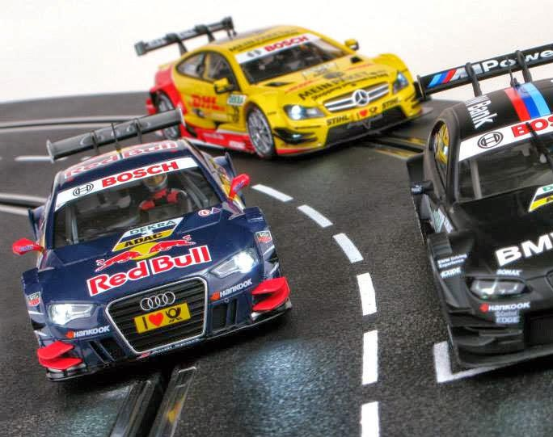
Using HTM to Perform Misbehavior Detection in Autonomous Vehicle Platoons
Ethan Swistak and Tushar Singhal

Slide 2
Week 3 – Progress Summary
Completed This Week | To-Do
Implemented metrics for HTM. Implemented thresholding and window filtering for Anomaly Scores. Implemented t-SNE for dataset. Implemented LSTM model and obtained results. | Use larger compute infrastructure for swarming Use Auto Encoder LSTM architecture for better results. Pass HTM outputs to Bayesian network.

Slide 3
Thresholding (threshold parameter)
1.0
0.5
0.0

Slide 4



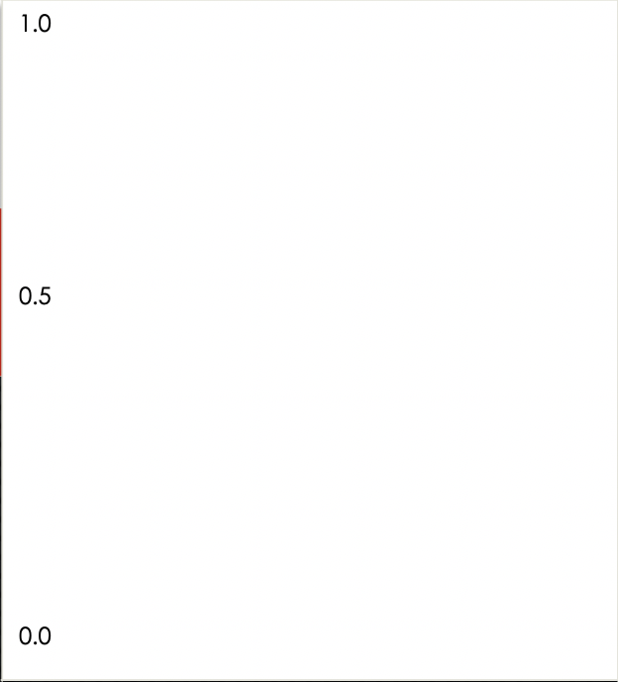
WINDOW FILTERING – (window size, No. of SPikes)
No of spikes
Window size - 10
>=4
thresholding
<4

Slide 5
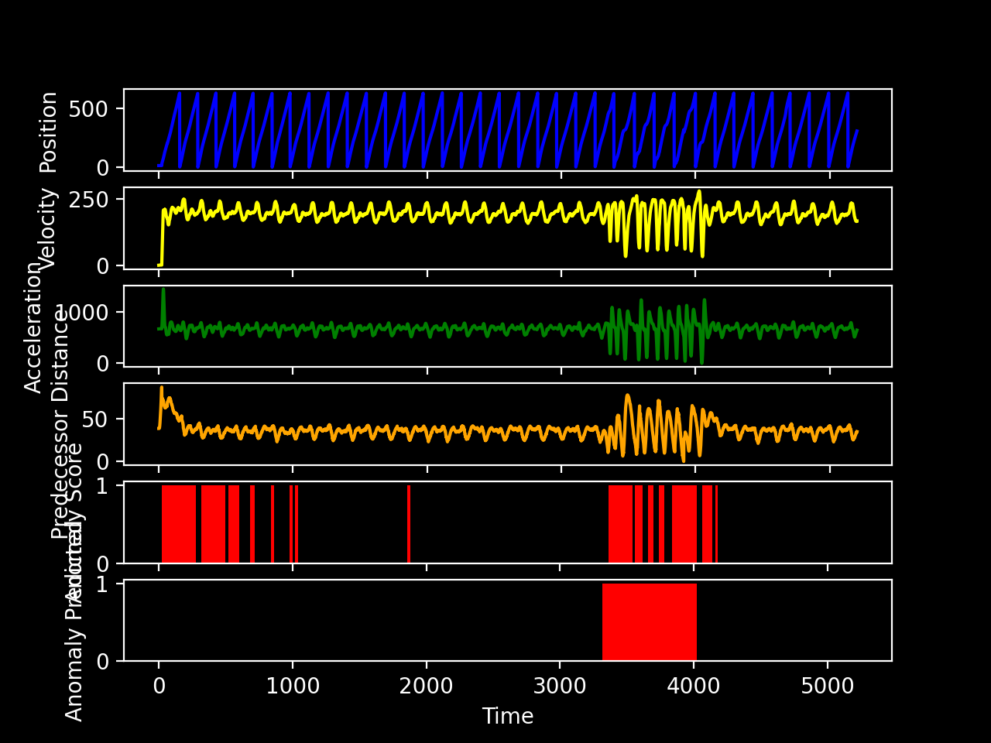
Results
Accuracy: 0.918957
Precision: 0.781250
Recall: 0.712251
F1 score: 0.745156

Slide 6
LSTM Architecture
_________________________________________________________________
Layer (type) Output Shape Param #
=================================================================
lstm (LSTM) (128, 7, 32) 4352
_________________________________________________________________
lstm_1 (LSTM) (128, 8) 1312
_________________________________________________________________
repeat_vector (RepeatVector) (128, 7, 8) 0
_________________________________________________________________
lstm_2 (LSTM) (128, 7, 8) 544
_________________________________________________________________
lstm_3 (LSTM) (128, 7, 32) 5248
_________________________________________________________________
time_distributed (TimeDistri (128, 7, 1) 33
=================================================================
Total params: 11,489
Trainable params: 11,489
Non-trainable params: 0
_________________________________________________________________

Slide 7
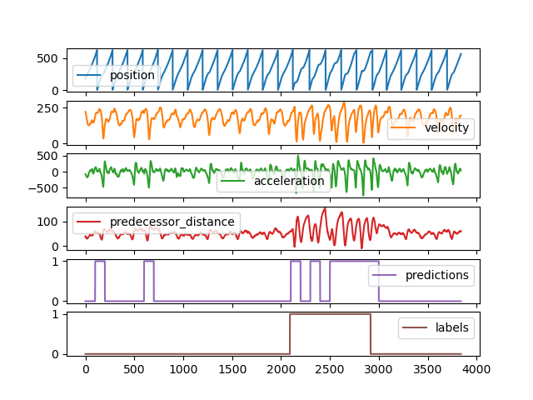
LSTM Results
Accuracy: N/A
Precision: 0.6844
Recall: 0.7467
F1 score: 0.7142

Slide 8
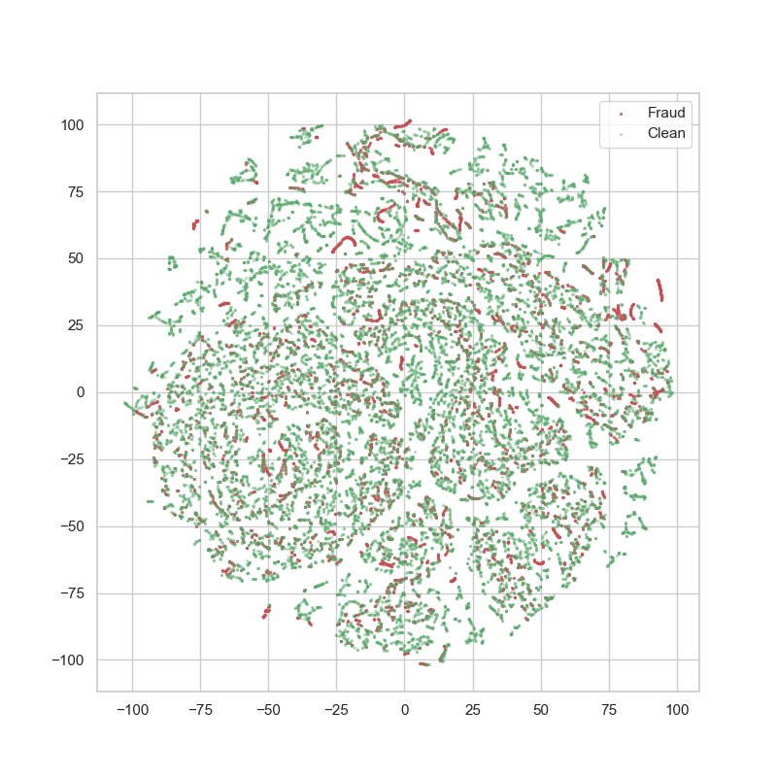
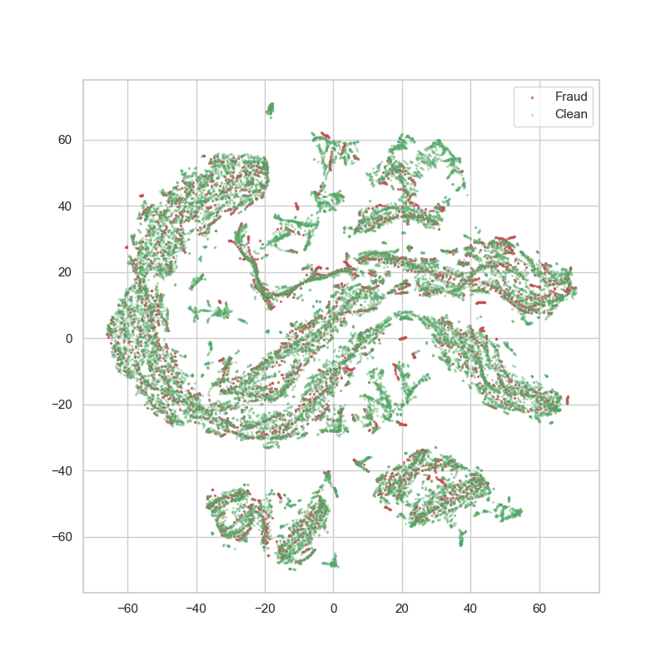
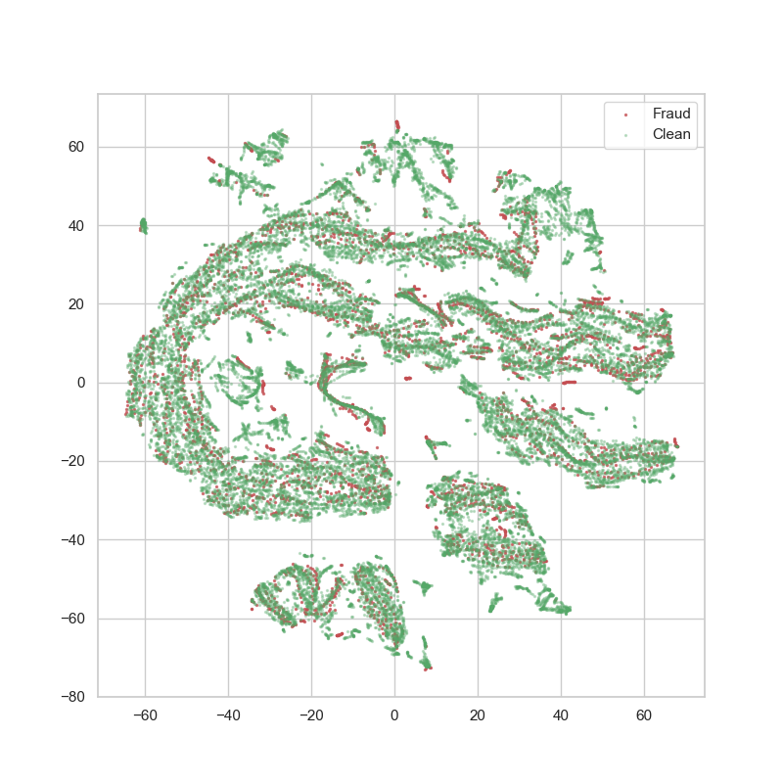
TSNE results
Perplexity 10 50 75

